Slide 1
Data processing

Slide 3
Pandas

Slide 4
Advantages
Disadvantages
Data representation
Steep learning curve
Less writing and more work done
Difficult syntax
An extensive set of features
Poor compatibility for 3D matrices
Efficiently handles large data
Bad documentation
Makes data flexible and customizable
Made for Python

Slide 5
Pandas visualization
matplotlib lib

Slide 6
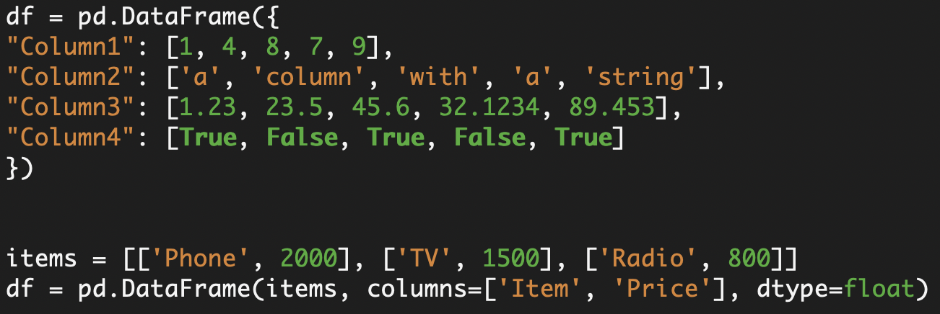
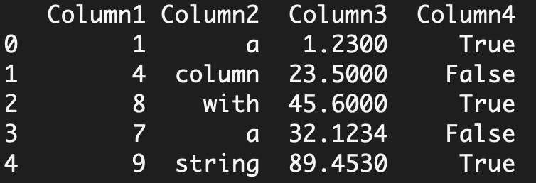
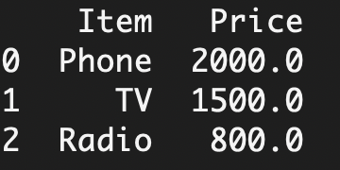
Pandas dataframe
2D labeled, size-mutable tabular structure with heterogenic columns

Slide 7
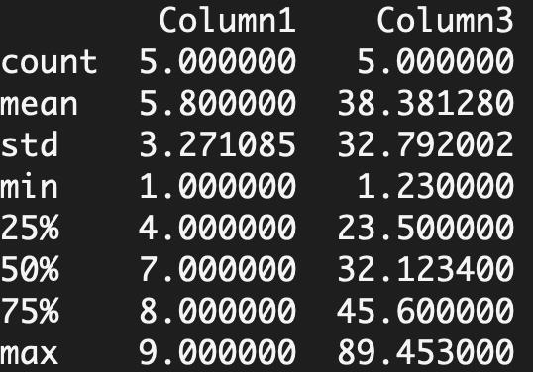
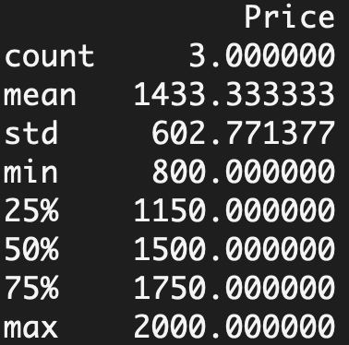
Pandas dataframe.describe()
describe() function excludes the character columns and gives summary statistics of numeric columns

Slide 8

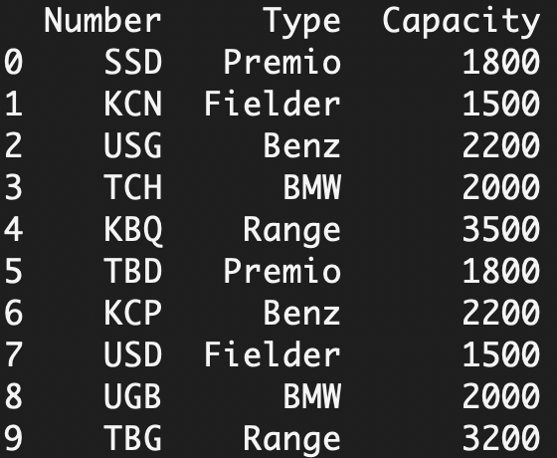
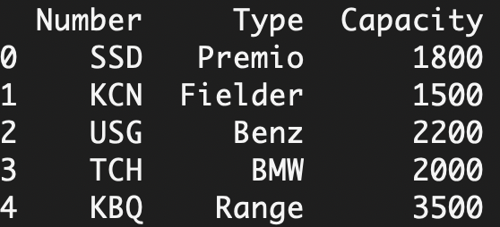
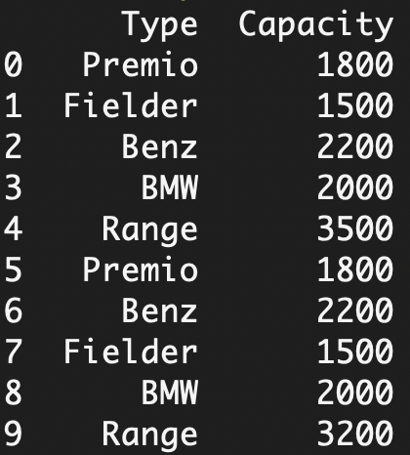
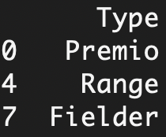
Useful funcs
df.head() - returns only the first 5 rows of the dataset, allowing you to inspect a small sample of the data.
df.loc() - method is a nice utility that helps us read only certain rows of a specific column.

Slide 9
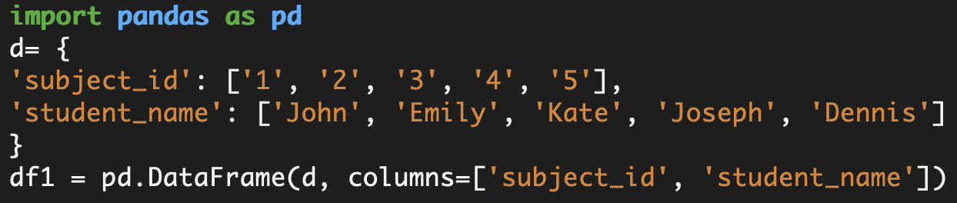
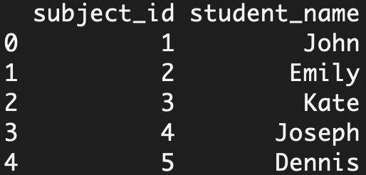
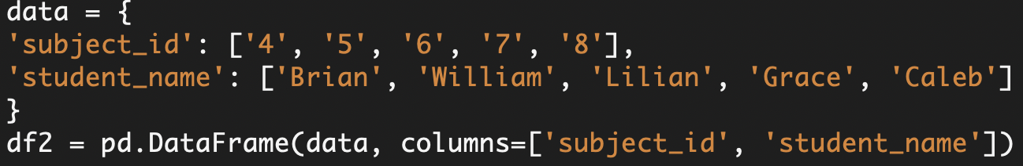
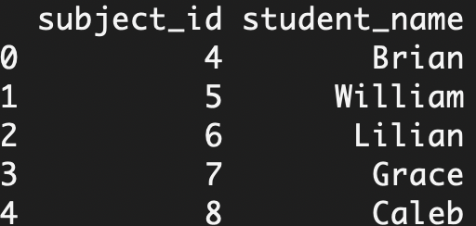
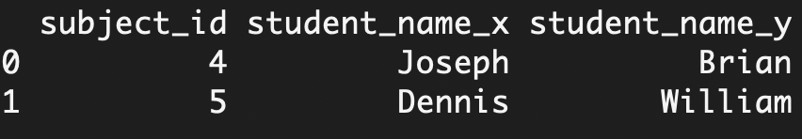
Pandas merge()

Slide 10
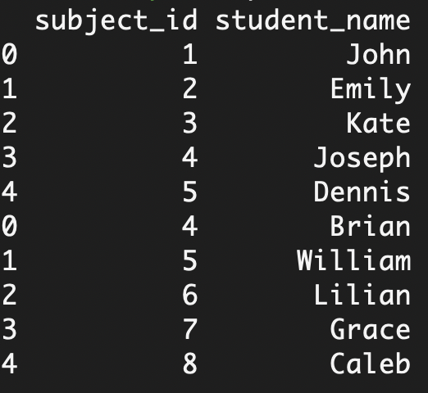
Pandas concat()

Slide 11
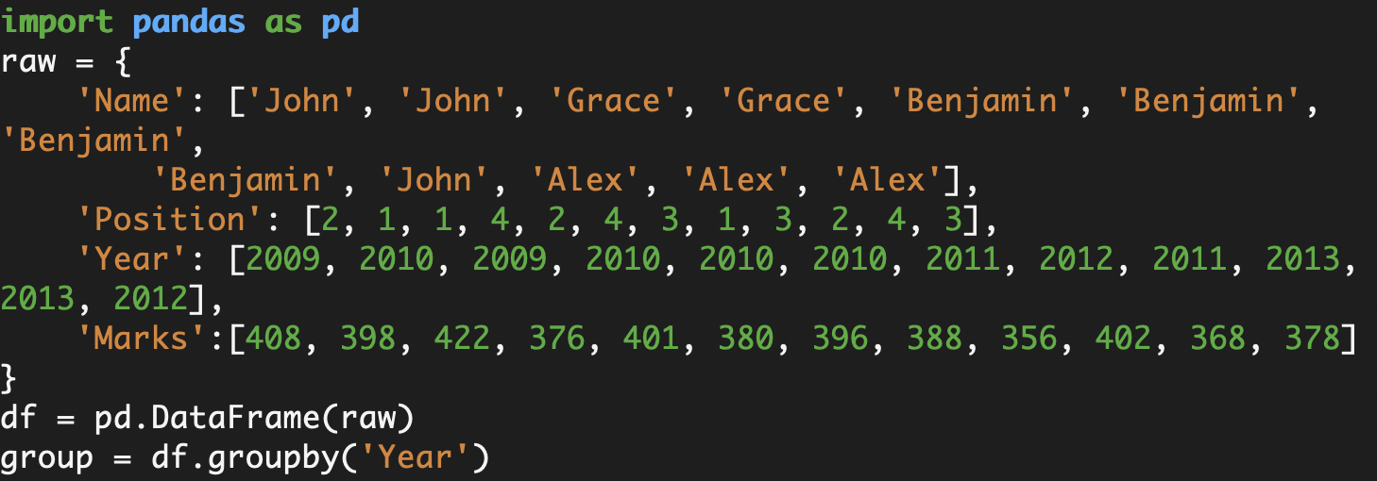
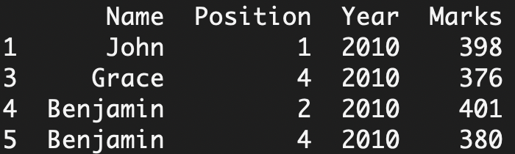
Pandas group()

Slide 13
In-Memory Computations
Lazy Evaluation
Persistence
Fault Tolerance
Partitioning
Immutability

Slide 14
Spark Eco-System
Spark SQL
Spark Machine Learning
Spark core
Spark Streaming
GraphX

Slide 15
In-Memory Computations
It improves the performance by an order of magnitudes.
Lazy Evaluation
All transformations in RDDs are lazy, i.e, doesn’t compute their results right away.
Fault Tolerant
RDDs track data lineage information to rebuild lost data automatically.
Immutability
Data can be created or retrieved anytime and once defined, its value can’t be changed.
Partitioning
It is the fundamental unit of parallelism in PySpark RDD.
Persistence
Users can reuse PySpark RDDs and choose a storage strategy for them.
Coarse-Grained Operations
These operations are applied to all elements in data sets through maps or filter or group by operation.

Slide 16
Operations
Actions
Transformations
Wide
Narrow
Collect
Count
Foreach
Reduce
Take
Show
Intersection
Distinct
ReduceByKey
GroupByKey
Join
Cartesian
Coalesce
Repartition
Map
FlatMap
MapPartition
Filter
Sample
Union

Slide 17
Main flow

Slide 18
Working of Spark Architecture

Slide 19
Working of Spark Architecture (user side)

Slide 20
DAG
(Directed Acyclic Graph) DAG in Apache Spark is a set of Vertices and Edges, where vertices represent the RDDs and the edges represent the Operation to be applied on RDD. In Spark DAG, every edge directs from earlier to later in the sequence. On the calling of Action, the created DAG submits to DAG Scheduler which further splits the graph into the stages of the task.

Slide 21
Dask
An efficient data pipeline means everything for the success of a data science project. Dask is a flexible library for parallel computing in Python that makes it easy to build intuitive workflows for ingesting and analyzing large, distributed datasets. Dask provides dynamic task scheduling and parallel collections that extend the functionality of NumPy, Pandas, and Scikit-learn, enabling users to scale their code from a single laptop to a cluster of hundreds of machines with ease.

Slide 22
Dask
Structured data
Unstructured data
Dataframes
Arrays
Bags
Dask Dataframe is simply a parallel collection of Pandas Dataframe
Parallel collection of Python objects
Functioning is similar to PySpark RDDs
Can load larger the memory data into Dask Dataframes
Use dask.multiprocessing, allowing the bypassing of GIL
Dask API the same as Pandas API
Dask Arrays store multiple NumPy arrays

Slide 23
Dask
Most consumer CPUs have multiple cores, at least 4 in the case of an Intel i5 and even hitting 16 for the newer Intel i9. If you need more, you can pretty easily spin up a compute-optimized instance on AWS with 96 virtual CPU cores. GPUs can potentially offer even more speed with thousands of CUDA cores available.
Dask allows you to pick from any of those options at any time, along with the ability to scale them up and down. Working with big data in Pandas had three main challenges: fitting the data into memory, processing it fast, and scaling the whole thing. But we have Dask

Slide 24
Dask
To manage memory consumption, Dask will keep the data stored on disk (your hard drive) and load chunks of the data (smaller parts) as needed for processing. This is similar to how you would do chunking with Pandas, only this time it’s handled entirely by Dask and is optimized. During the processing, the intermediate values generated (if any) are discarded as soon as possible to save on memory, so Pandas is only ever working with as much data as it absolutely needs, no more.
Dask seamlessly performs parallel processing on a single machine using all available CPU cores. You don’t have to write any custom code to get it to work efficiently. Dask just uses the cores naturally, out of the box.
Dask scales seamlessly to any number of cores and across any number of machines. It uses all the cores of larger clusters, such as those in the cloud, as if they were in one single machine. It’s not necessary for the instances in the cluster to have the same number of cores or have the same power. Dask will use them all together, applying whatever resources it has available to it to process the DataFrame.

Slide 25
Dask
To manage memory consumption, Dask will keep the data stored on disk (your hard drive) and load chunks of the data (smaller parts) as needed for processing. This is similar to how you would do chunking with Pandas, only this time it’s handled entirely by Dask and is optimized. During the processing, the intermediate values generated (if any) are discarded as soon as possible to save on memory, so Pandas is only ever working with as much data as it absolutely needs, no more.
Dask seamlessly performs parallel processing on a single machine using all available CPU cores. You don’t have to write any custom code to get it to work efficiently. Dask just uses the cores naturally, out of the box.
Dask scales seamlessly to any number of cores and across any number of machines. It uses all the cores of larger clusters, such as those in the cloud, as if they were in one single machine. It’s not necessary for the instances in the cluster to have the same number of cores or have the same power. Dask will use them all together, applying whatever resources it has available to it to process the DataFrame.

Slide 26
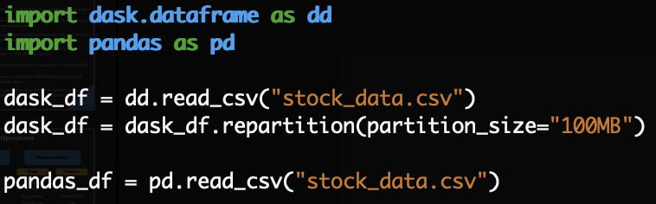
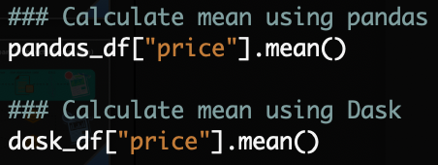
Dask
Code like in Pandas

Slide 27
Thank you

